Slide 1

Posey Performance Analysis
PRESENTED BY: DATA BENDERS
OLUWAKAYODE OJO
LEWIS SAWE
JULIUS SAMI ALHERI
KENECHUKWU JANE IBEZIM
ADESAYO LABAEKA

Slide 2

Overview
We explored five datasets (orders, web_events, accounts, sales_reps, region) from the Posey PostgreSQL database.
The goal was to uncover patterns in sales, customer behavior, marketing, and regional performance. Our team collaborated by analyzing different tables, sharing insights, and building a unified presentation for management.
PARCH & POSEY

Slide 3
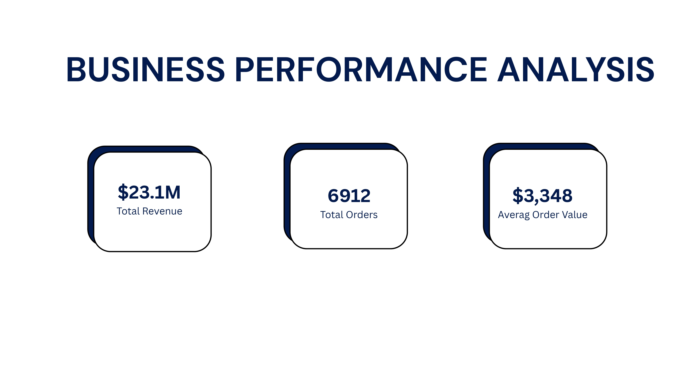
PARCH & POSEY

Slide 4
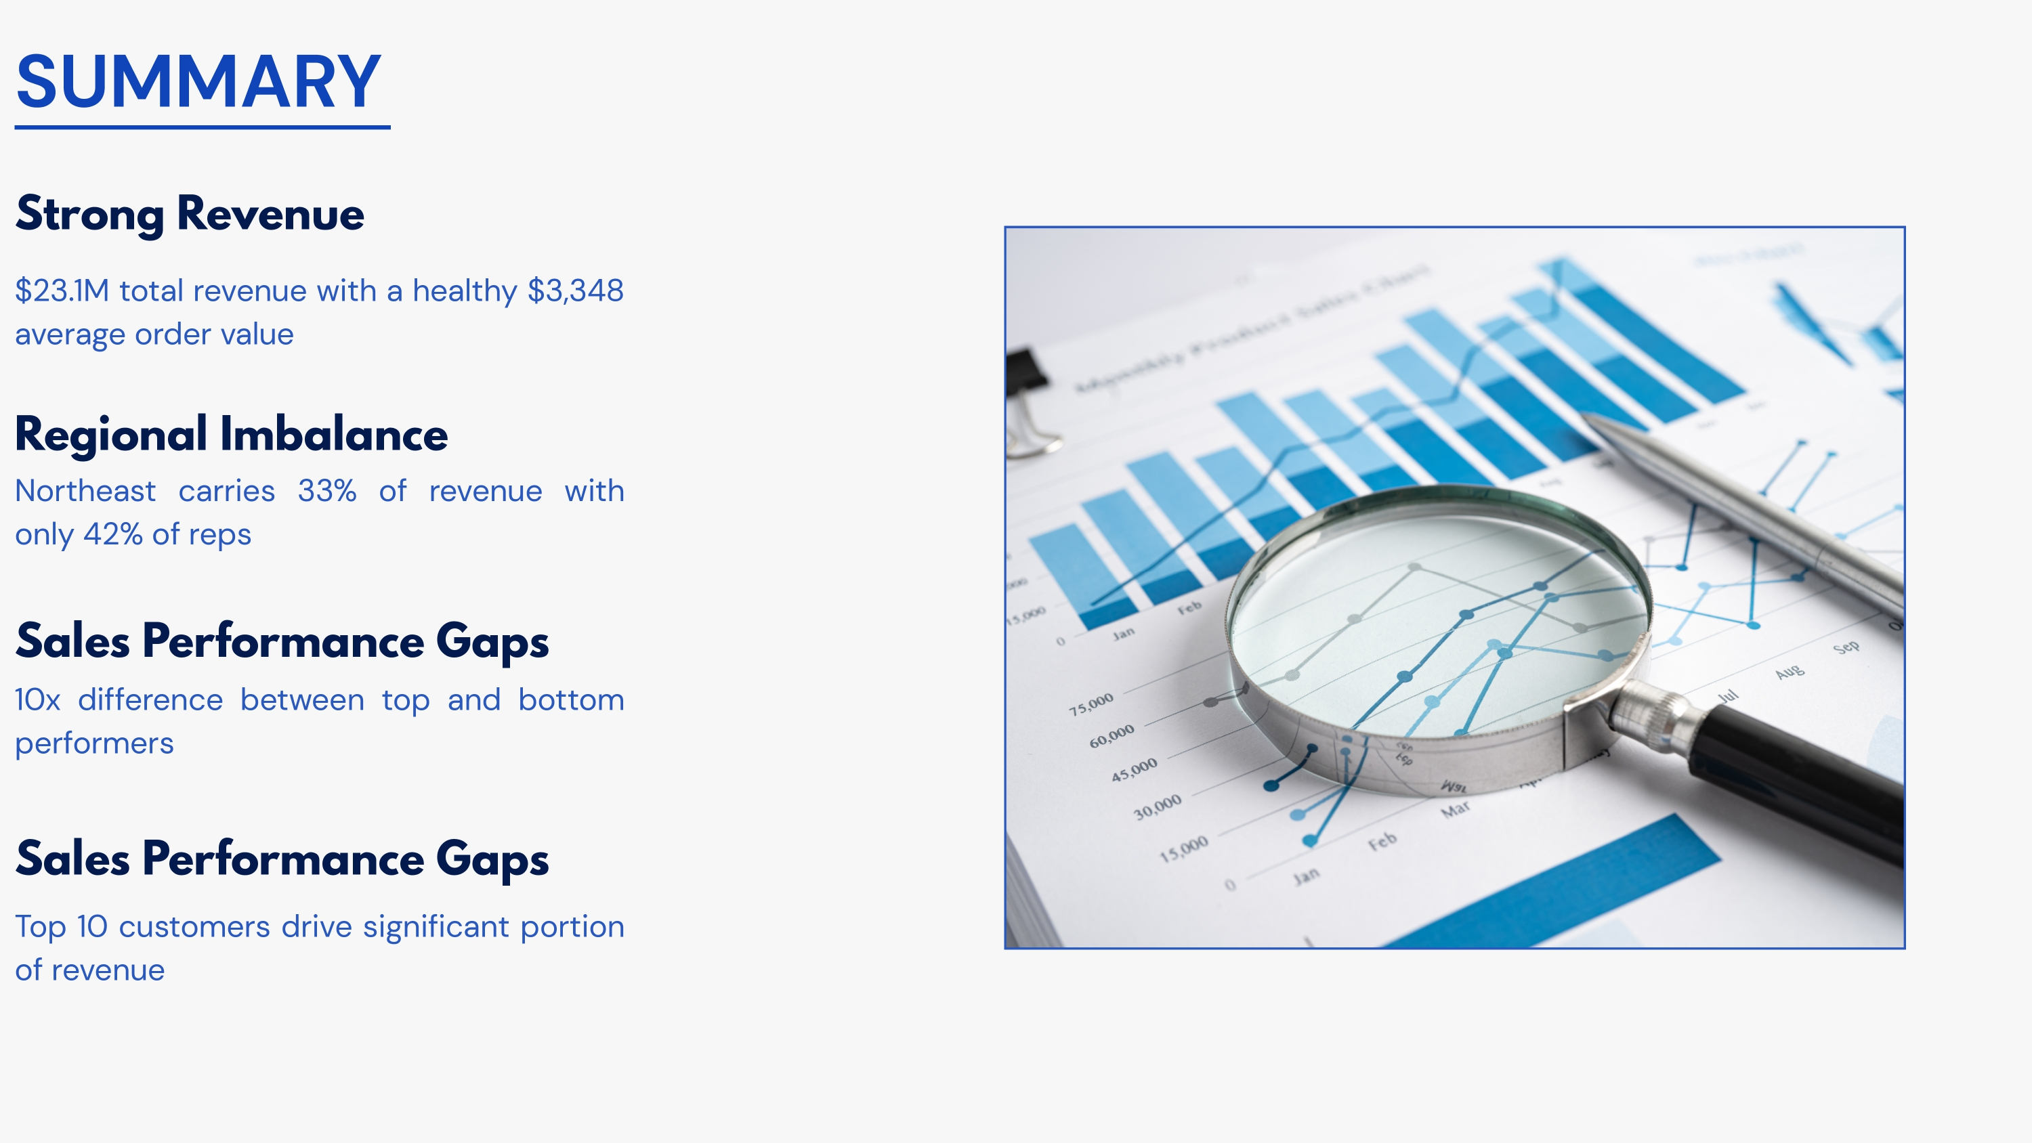
PARCH & POSEY

Slide 5
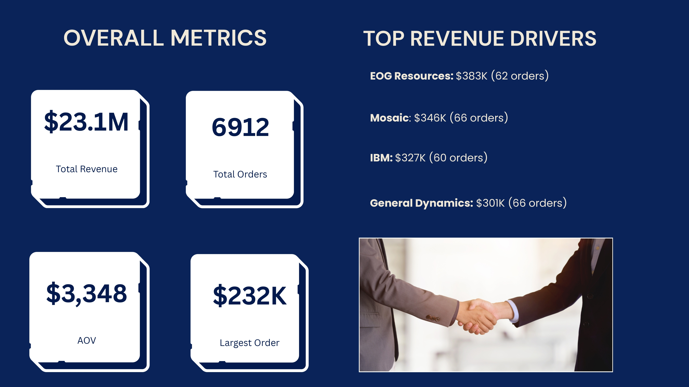
PARCH & POSEY

Slide 6
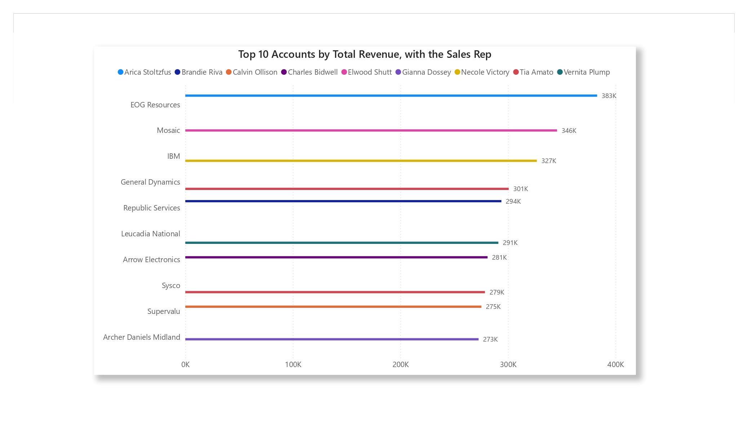
High-Value Accounts and Their Sales Reps
PARCH & POSEY

Slide 7
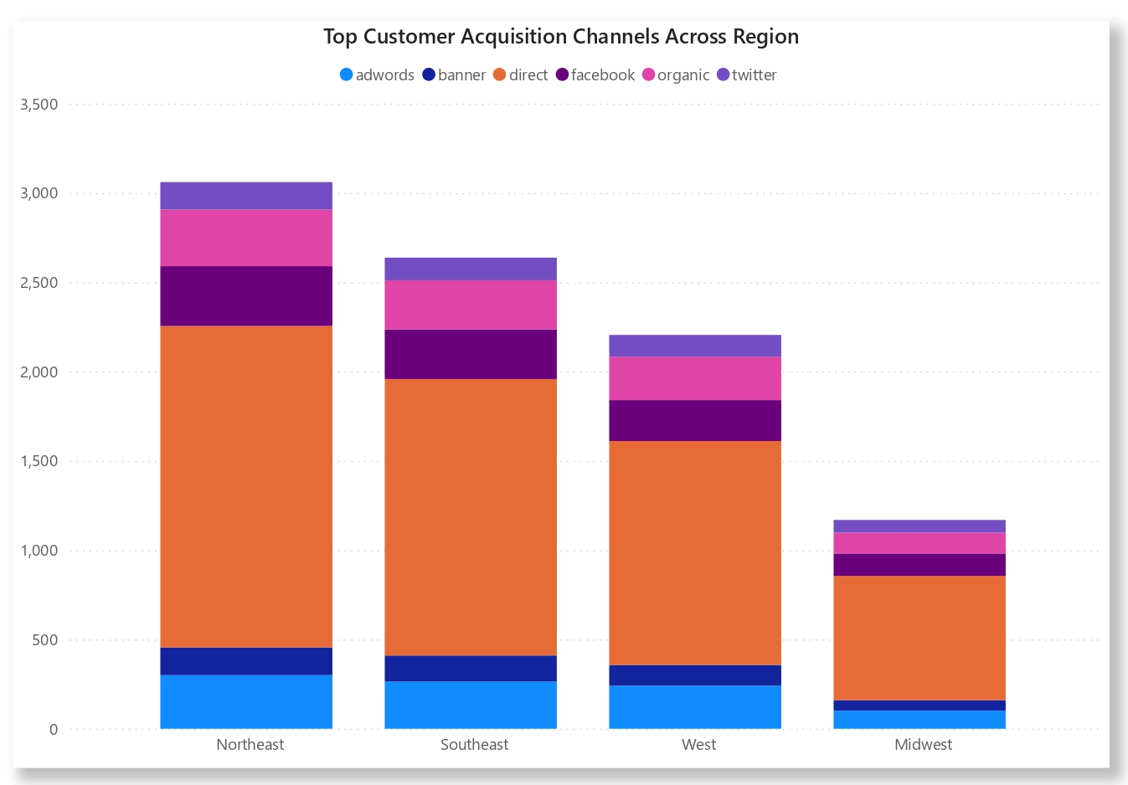
Top Acquisition Channels by Region
PARCH & POSEY

Slide 8
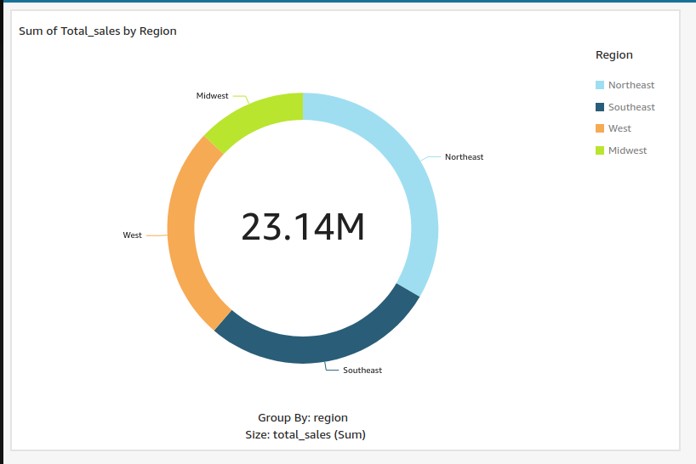
Sales By Region
PARCH & POSEY

Slide 9
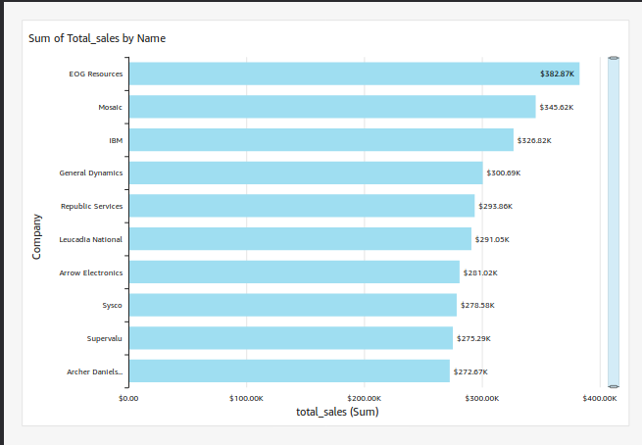
Sales By Company
PARCH & POSEY

Slide 10
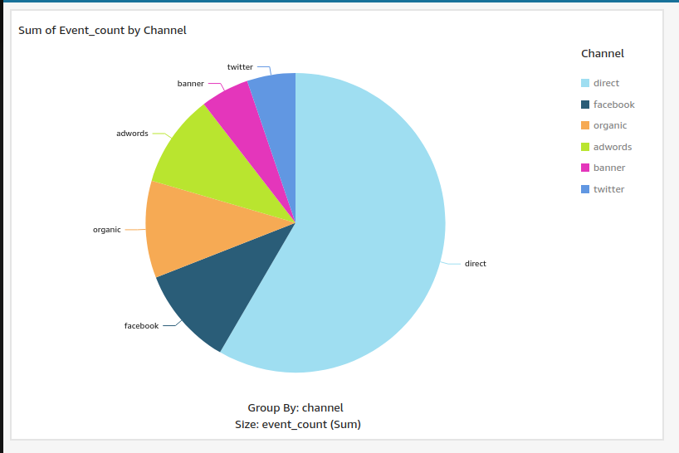
Web Event By Channel
PARCH & POSEY

Slide 11
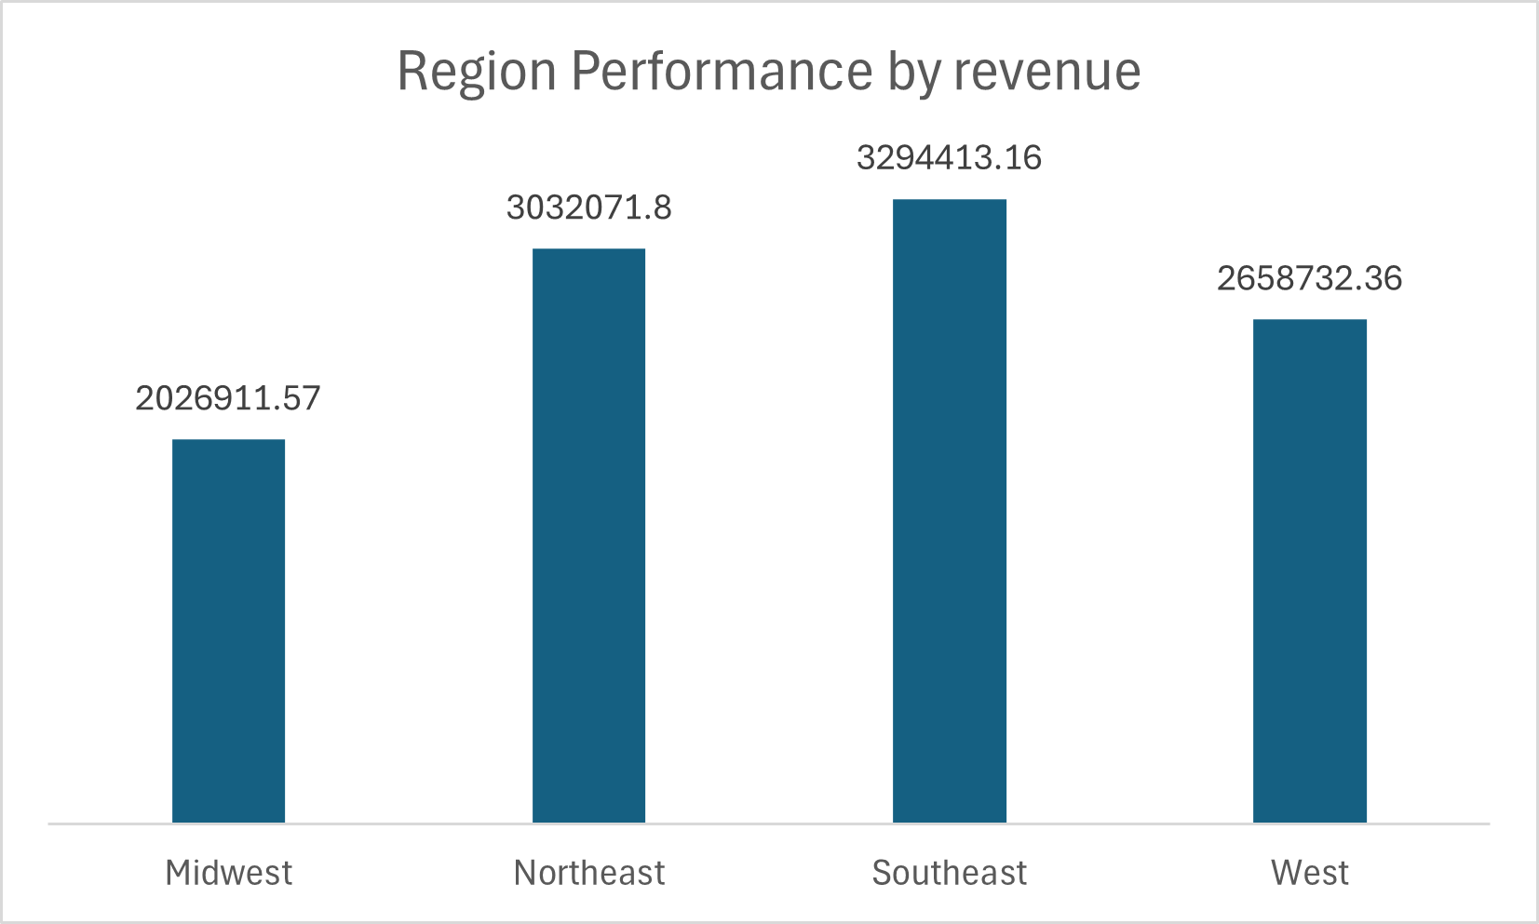
Region Performance By Revenue
PARCH & POSEY

Slide 12
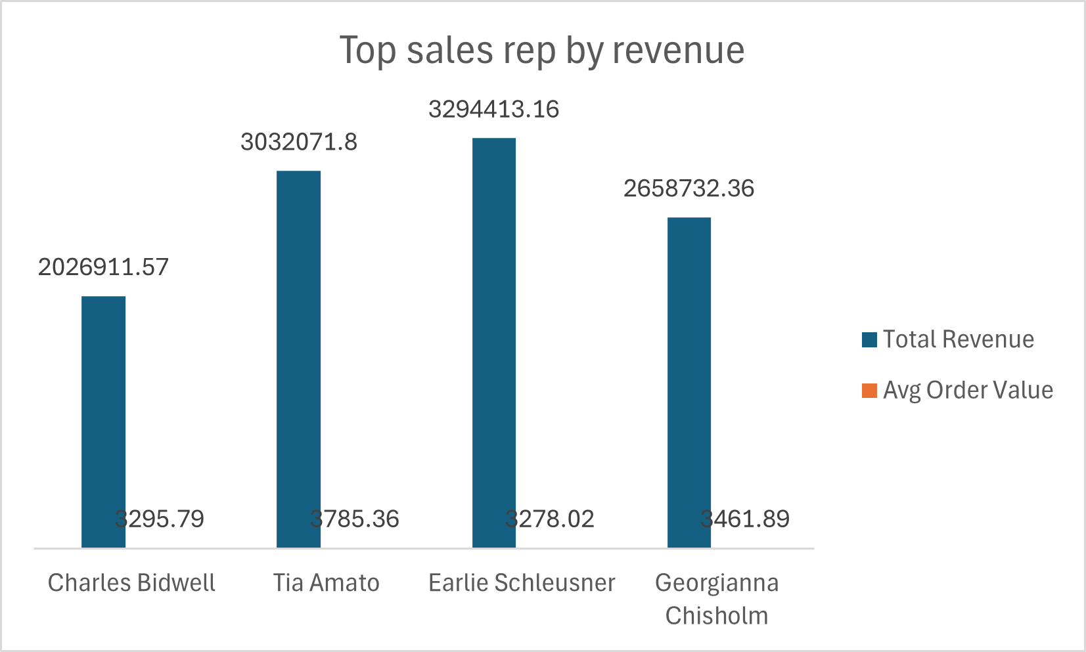
Top Sales Rep By Revenue
PARCH & POSEY

Slide 13
Yearly Growth of Revenue
PARCH & POSEY

Slide 14
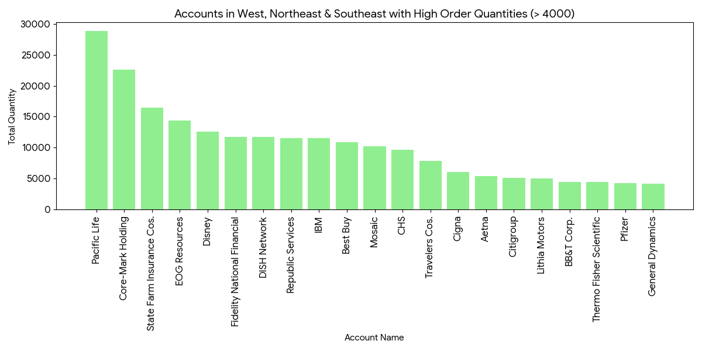
Accounts in Regions With High Order Quantities
PARCH & POSEY

Slide 15
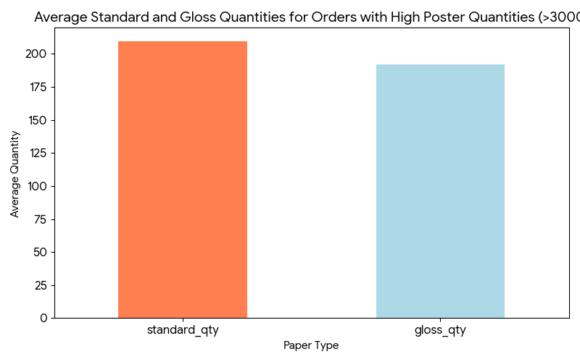
Orders with High Quantity
PARCH & POSEY

Slide 16

Summary
Our analysis of the Parch & Posey database revealed the company’s top revenue-generating accounts and the sales reps driving the most value. We identified the leading customer acquisition channels and how they vary across regions, highlighting opportunities to optimize marketing spend. Regional analysis showed differences in sales performance, revenue contribution, and order volumes, with some regions consistently outperforming others. At the company level, we compared sales across accounts, uncovering high-order customers and top-revenue contributors. Web events by channel gave visibility into customer engagement and traffic sources, while yearly revenue trends confirmed steady growth over time. Overall, these insights provide a clearer picture of where the business earns the most value and where strategic improvements can drive further growth.
PARCH & POSEY

